Slide 1
MYOCARDITIS
Dr. S G Shyam Lakshman
Senior Resident
Dept of Cardiology

Slide 2
History and introduction
Epidemiology and aetiology
Pathogenesis
Clinical features
Diagnosis
Management

Slide 3
Old and New….
1749-Jean Baptiste Senac in Versailles, France-Traité des Maladies du Coeur (Treatise on Disease of the Heart).
1837-Myocarditis- Joseph Freidrich Sobernheim.
1980s - World Health Organization and the International Society and Federation of Cardiology attempted to differentiate both

Slide 4
Definition
1995, myocarditis was defined by the World Health Organization (WHO)/International Society and Federation of Cardiology (ISFC) as
Inflammatory disease of the heart muscle, diagnosed by established histological, immunological, and immuno histochemical criteria

Slide 5
Inflammatory disease of heart muscle cells
Inflammation – damage- ischemic damage, mechanical trauma, genetic cardiomyopathies.
Classic paradigm of cardiac injury----immunologic response from the host.
Overwhelming or inappropriate immune response may destroy the heart tissue.
Chronically cardiac remodelling leads to DCM, heart failure, or death.
Self limiting.

Slide 6
Dallas criteria.
Criteria criticized because of inter reader variability in interpretation, lack of prognostic value, and low sensitivity due in part to sampling error
Caforio et al (2013) in defining myocarditis, using immuno histochemical data
≥14 lymphocytes/mm² including ≤4 monocytes/mm²
CD3-positive T lymphocytes ≥7 cells/mm².
EMB and Post mortem patients.
Useful in sub acute or chronic myocarditis.

Slide 9
Magnitude of the problem
Global prevalence of myocarditis ≈22 of 100 000 patients annually-I C D--International Classification of Diseases (ninth revision).
I C D 9---0.5% and 4% of cases of prevalent heart failure are due to myocarditis.
AHA-myocarditis as the third leading cause of sudden cardiac death in competitive athletes.(Maron et al- Circulation 2015)
Autopsy studies- myocarditis is responsible for 4-12% of SCD.

Slide 10
Aetiology
Commonly viruses.
1950s to the 1990s- Entero viruses.
Last 2 decades- PCR and in situ hybridization led to other viruses.
Selected bacteria- diphtheria, Borrelia.
T. cruzi in Endemic areas

Slide 11
Hypersensitivity myocarditis
Vaccines
Drugs
Systemic autoimmune diseases.

Slide 14
Pathogenesis
Experiments on rodent strains.
Cardio virulent virus strain , parasites, or bacteria.
Delivery of cardiac antigens with a strong adjuvant or carried within dendritic cells in non infectious models.
Viral entry into cardio myocytes → type 1 interferons.
Leads to myocyte death by apoptosis and autophagy.

Slide 15
Receptors like CAR and CD55.
Chaga’s Disease-parasites releasing bioactive compounds and promoting oxidative stress.
2nd Phase-
NO,
Altered regulatory T-cell,
NK cells
Type I interferon
Clearance – Normal cardiac function.
3 ^{rd} Phase-------Chronic auto antigen-driven inflammation→ DCM and end-stage heart failure

Slide 16
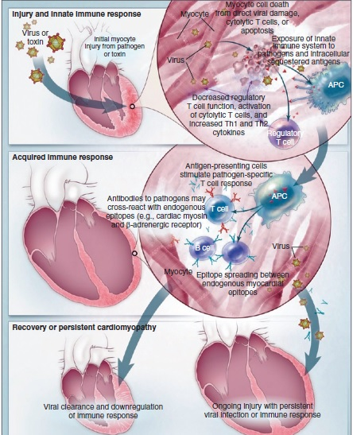

Slide 17
Time Course in Myocarditis
Entry of virus------- Receptor mediated
Acute-----Virus replication - myocyte necrosis, exposure of intracellular antigens
Subacute-----virus-specific T lymphocytes, which may target the host’s organs.

Slide 19
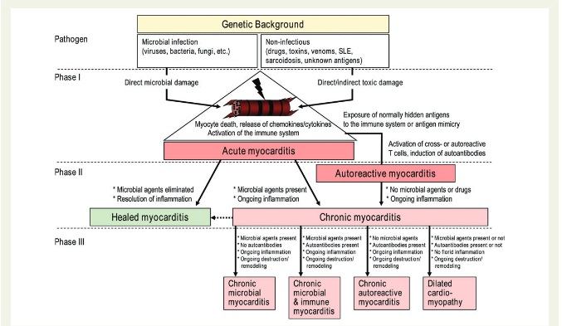

Slide 20
CARDIAC INFLAMMATION
CELLULAR
EXTRACELLULAR
T and B Cells
Macrophages
Dendritic Cells
Eosinophils
Mast Cells
Fibroblasts
Myofibroblasts
Stromal cells

Slide 21
Activation, deactivation or trans differentiation of specific cell subsets, are
1.chemokines,
2. cytokines
3. hormones, and degradation or danger
Activate or inhibit gene expression through more or less specific receptors and their intracellular downstream pathways

Slide 22
Mechanisms
Activated APC’s
CD4+T Cells
IFN-γ, IL-4, -5, and -13, IL-17
Progression to DCM
Promote T cell expansion
Chronic myocarditis and heart failure
Activated TLRs
TNF-α, IL-1β, IL-18, or high-mobility
group box 1 protein
Cardiac fibrosis
Heart failure progression

Slide 25
Epigenetics
mi RNA’s
Modulate expression of active proteins
mi RNA’s dysregulation and myocarditis.
miRNA-155, -146b, and -21 in CSB
Modulate virulence.
miRNA-221/222

Slide 26
Clinical Features
Chest pain and dyspnoea.
Preceded by viral prodrome URI or GI.
Chest pain resembles MI or pericarditis.
Myo-pericarditis in 11%( Imazio et al-circulation 2013)
Angina Coronary vasospasm
Micro vascular dysfunction
Palpitations and syncope.
Heart failure and sudden cardiac death.

Slide 27
Prevalence of myocarditis as a cause of cardiomyopathy----Bimodal peaking---- first year of life, declines during late childhood, and peaks in the early 20s.
Men ------severe course------less complete recovery
EMB-----------------Mobitz type 2 second-degree or higher heart block
Sustained or symptomatic ventricular tachycardia not responding to treatment.
GCM, CS, and necrotizing eosinophilic myocarditis have higher incidence of arrhythmias.
Eosinophilic and myocarditis associated with systemic inflammatory disorders

Slide 28
EMB is infeasible or is not clearly indicated----------non invasive diagnostic ------- probable acute myocarditis.
European Study of Epidemiology and Treatment of Inflammatory Heart Disease, 3055 patients with suspected acute or chronic myocarditis were screened, whereupon 72% had dyspnea, 32% had chest pains, and 18% had arrhythmias (Hufnagel G et al Herz.2000).
Studies limited- protean manifestations and lack of non invasive diagnostics.

Slide 29
Specific Clinical Presentations
Acute Myocarditis
Nonspecific symptoms
Kuhl et al- fatigue (82%), DOE (81%), arrhythmias (55%, both supraventricular and ventricular), palpitations (49%), and chest pain at rest (26%).
Viral pro drome---20-80%.
Diagnosis of exclusion.

Slide 30
Fulminant Myocarditis
10% biopsy proven.
Abrupt onset(≤2 weeks).
Haemodynamic compromise.
Echo-Global LV dysfunction and myocardial oedema.
EMB- diffuse myocarditis.
Supportive treatment.

Slide 31
Giant Cell Myocarditis
Subtle onset
Present with heart failure, arrhythmia and heart block.
Survival <6 months
Improved with immuno suppressants.
Discontinuation ---------- recurrence.
EMB---- Giant cells and scar tissue.
Cardiac transplantation+ mechanical circulatory support.

Slide 32
Chronic Active Myocarditis
Older
Insidious
Features of LV dysfunction.
EMB---fibrosis and myocyte dropout.
60-70% of patients-----DCM with unknown aetiology.
MRI, PET-CT, Immunohistochemistry

Slide 33
Differentials
Ischaemic heart disease.
Hypertrophic cardiomyopathy.
Cardiac amyloidosis.
Arrythmogenic right ventricular cardiomyopathy.
Pieroni et al -patients with right ventricular myocarditis ---indistinguishable from ARVC ---- clinical features, presence, and severity of structural and functional right ventricle abnormalities ( J Am Coll Cardiol.2009).

Slide 35
Diagnostics
E C G
Low sensitivity – used for screening.
Nonspecific T waves and ST-segment changes including ST-segment elevation.
Arrhythmias.
Risk stratification and initial screening
Ukena et al - prolonged QRS duration is a significant independent predictor for cardiac death or heart transplantation ( Eur J Heart Fail. 2011)

Slide 36
Echocardiography
Diagnostic assessment- R/O other causes of HF.
Cardiac chamber sizes, wall thicknesses, and systolic and diastolic functions.
Fulminant myocarditis lack cardiac dilation and exhibit increased septal thickness.
Spherical-shaped ventricle ------elliptical ----------normal wall thickness.
Speckle tracking-Hsiao et al - LV strain and strain rate may be useful measurements for diagnosis of suspected myocarditis patients, even those with preserved LVEF( Int J Cardio vasc Imaging 2013)

Slide 37
Blood
Cardiac Troponins-Acute or fulminant DCM with heart failure.
Sub acute or chronic myocarditis biomarkers are usually normal.
Cardiac Magnetic Resonance
CE-CMR----detect areas of myocardial damage in patients with acute myocarditis.
cMRI sensitivity and specificity are as high as 100% and 90%.

Slide 38
T2-weighted CMR -oedema or water.
T1-weighted sequences -inflammation or fibrosis.
LGE------CS --------multiple, patchy mid myocardial lesions in a non coronary -------------septal and RV involvement.
Acute DCM, CMR -myocarditis predict a greater likelihood of recovery, defined as a left ventricular ejection fraction (LVEF) >55% after 24 months

Slide 39
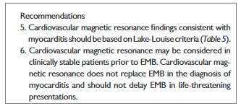
Regional or global T2-weighted “oedema-sensitive” sequences also had a significant improvement in LVEF at 12-month follow-up(Vermes et al- Eur Heart J Cardio vasc Imaging 2014).
LGE -3.7%/year risk of a composite of cardiovascular adverse events.
LGE predicted a composite endpoint of cardiac death, heart failure hospitalization, ventricular tachycardia, and sudden death( Schumm J et al-J Cardiovas Magn Reson 2014.)

Slide 40
Rim-like pattern --- septal wall or a sub epicardial distribution ----free LV lateral wall - PVB19.
PVB19 ---- CE -lateral wall
HHV6 -----CE -mid wall ----inter ventricular septum.
CE- CMR : Guidance for EMB sampling when necessary.
Lacks the ability to determine the magnitude of inflammation.
Acute not in chronic myocarditis.
c MRI is a reliable method of detecting myocardial fibrosis in DCM

Slide 42
Endomyocardial Biopsy
Lymphocytic infiltration in association with myocyte necrosis and death.
Best method to differentiate between giant cell myocarditis and sarcoidosis.
Eosinophilic myocarditis -myocyte necrosis---intra cavitary thrombi containing eosinophils----lumen of intra myocardial coronary vessels.

Slide 43
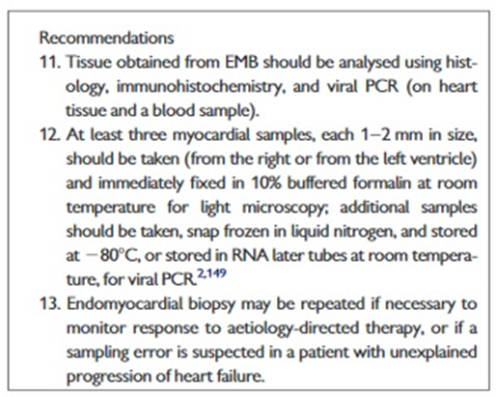
ESC recommends EMB------ as early as possible.
ACC/AHA recommends EMB based on 3 classes of comprehensive clinical presentations, risks, and measurements using non invasive techniques.
Immunohistochemistry useful.

Slide 44
Kindermann et al ----69 of 181 (38%) EMB samples are positive for myocarditis using the Dallas criteria, whereas 91 of the 181 (50%) ---------CD3, CD68 (macrophages), and HLA class II antibodies (Circulation. 2008)
Sensitivity →EMB -----------→GCM ------------------80% to 93%
Lymphocytic & Sarcoid ------20% to 30%

Slide 47
Micro-RNA Profiling
Characterisation of mi RNA profiles among acute, chronic, and fulminant myocarditis including a relationship to the severity of myocardial damage.
miR-208b and miR-499 are up regulated upon myocardial damage.
miR-155, miR-21, miR-146b, miR-511, and miR-212 are upregulated in myocarditis.

Slide 48
CpG dinucleotide methylation regulates parvovirus 19 (PVB19) viral genome expression.
Minimum of 4 samples is needed to achieve an acceptable sensitivity for molecular diagnosis of erythro virus PVB19.
PVB19 (>250 copies/mg DNA) and for human herpes virus 6 (>500 copies/mg DNA).
Antiviral therapies beneficial in active inflammation.

Slide 49
FDG-PET----active myocardial inflammation----suspected CS.
FDG-PET +Myocardial perfusion---- active inflammation and scarring.
18F-FDG-PET ---extra cardiac inflammation
lymph nodes that are amenable to biopsy
Blankstein et al -------Mismatch of FDG and perfusion measurements predicts adverse cardiac events, and RV involvement is associated with high risk for arrhythmias

Slide 51
Treatment
Myocarditis presenting as heart failure with reduced systolic function
Current guidelines -gradual titration of ACE inhibitors, ARB’s and beta blockers, to doses used in clinical trials (Yancy CW et al J Am Coll Cardiol 2013).
Virus-negative inflammation-positive patients- Immunosuppression with azathioprine and prednisone for up to 12 months.

Slide 52
Pathogen Inhibition
Antivirals--------------Interferons-------------INF β and IFN-α2a.
Natural products like astragaloside IV -----↓ CVB3 titres by up regulating IFN-γ.
Chen et al -astragaloside IV ↓ fibrosis of the heart muscle tissue and ↑ the murine survival rate.
Antisense oligo deoxy nucleotides- target viral gene sequences ---inhibit viral gene expression and inhibit viral replication

Slide 53
Preventing viral entry-------dimeric antibody-like molecule----modified CAR or decay accelerating factor crystallization proteins.
Competitively ----viral particles ---------viral-specific activation of the innate and adaptive immunity.
Limitations
Nonspecific targeting,
Unclear mechanisms
Side effect

Slide 54
Doses
Interferon-β---2 × 10⁶ IU alternate day subcutaneous.
Increased at weekly intervals, first to 4 × 10⁶ IU and then to 6–8 × 10⁶ IU; this is continued for 24 weeks.
Slowly increasing dosage reduces flu like symptoms.

Slide 55
Immune modulation
Sub acute phase of myocarditis--------exaggerated autoimmune responses.
Azathioprine
Prednisalone
Non steroidal anti-inflammatory drugs have shown increased myocardial inflammation and mortality and hence avoided.
Tissue inhibitor of metalloproteinase 1–specific small interfering RNA or polyclonal antisera --------------- used as modulators.

Slide 56
Immunoglobulin therapy
Ineffective in acute DCM.
Chronic CMP with viral replication may benefit—Dennert et al (Antivir Ther 2010).

Slide 57
Steroids
Mainstay in CS.
Halt Progression of LV dysfunction
Survival doubtful-------- ( Blauwet -Heart Fail Rev 2012 )
Early initiation
AV block recovery----20-30%
GCM- cyclosporine based combined immunosuppression beneficial.

Slide 58
Other therapies
Trans venous pacing– Acute lymphocytic myocarditis.
Temporary
LV dysfunction--- wearable external defibrillator.
Class IIa recommendation for an ICD in patients with suspected CS, regardless of LV function or reversibility of heart block

Slide 59
Specific Regimens

Slide 62
Key Messages
Viral infections are the most common triggers of inflammatory myocardiopathies.
Non-specific symptoms are frequently identified and cardiologically evaluated only at an advanced stage.
Pathophysiological processes in myocarditis take place at the cellular and subcellular levels, myocardial biopsy is the only method for confirmation of diagnosis.
Clinical course of myocarditis is unpredictable, all patients with etiologically unexplained heart failure have to undergo myocardial biopsy.
Numerous chronic viral infections and postinfectious or autoimmune inflammations of the myocardium are treatable.

